Slide 1
Smoothing/Priors/ Regularization for Maxent Models

Slide 2
Smoothing: Issues of Scale
Lots of features:
NLP maxent models can have well over a million features.
Even storing a single array of parameter values can have a substantial memory cost.
Lots of sparsity:
Overfitting very easy – we need smoothing!
Many features seen in training will never occur again at test time.
Optimization problems:
Feature weights can be infinite, and iterative solvers can take a long time to get to those infinities.

Slide 3
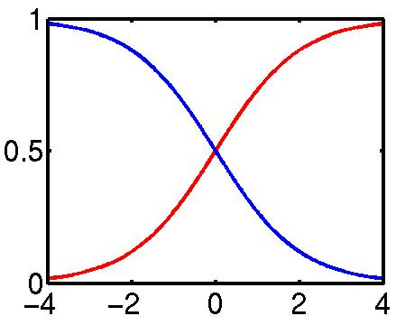
Smoothing: Issues
Assume the following empirical distribution:
Features: {Heads}, {Tails}
We’ll have the following model distribution:
Really, only one degree of freedom (λ = λ_{H}−λ_{T})
Heads | Tails
h | t
λ

Slide 4
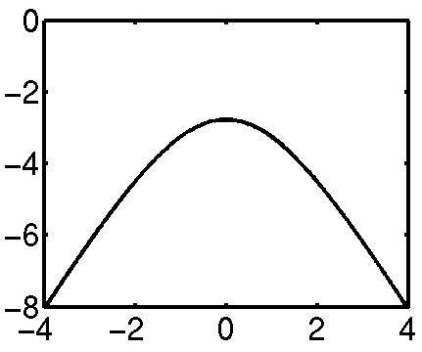
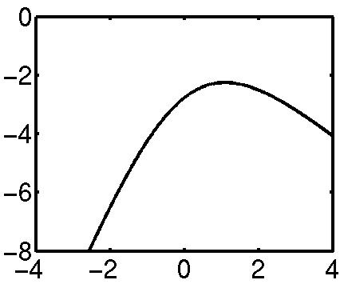
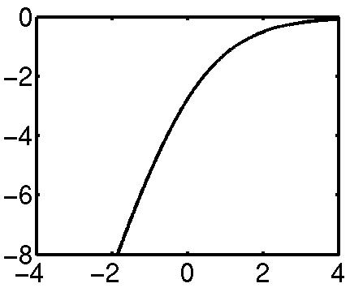
Smoothing: Issues
The data likelihood in this model is:
log P
log P
log P
λ
λ
λ
Heads | Tails
2 | 2
Heads | Tails
3 | 1
Heads | Tails
4 | 0

Slide 5
Smoothing: Early Stopping
In the 4/0 case, there were two problems:
The optimal value of λ was ∞, which is a long trip for an optimization procedure.
The learned distribution is just as spiked as the empirical one – no smoothing.
One way to solve both issues is to just stop the optimization early, after a few iterations.
The value of λ will be finite (but presumably big).
The optimization won’t take forever (clearly).
Commonly used in early maxent work.
λ
Heads | Tails
4 | 0
Input
Heads | Tails
1 | 0
Output

Slide 6
Smoothing: Priors (MAP)
What if we had a prior expectation that parameter values wouldn’t be very large?
We could then balance evidence suggesting large parameters (or infinite) against our prior.
The evidence would never totally defeat the prior, and parameters would be smoothed (and kept finite!).
We can do this explicitly by changing the optimization objective to maximum posterior likelihood:
Posterior
Prior
Evidence

Slide 7
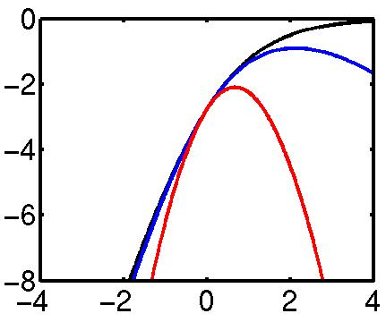
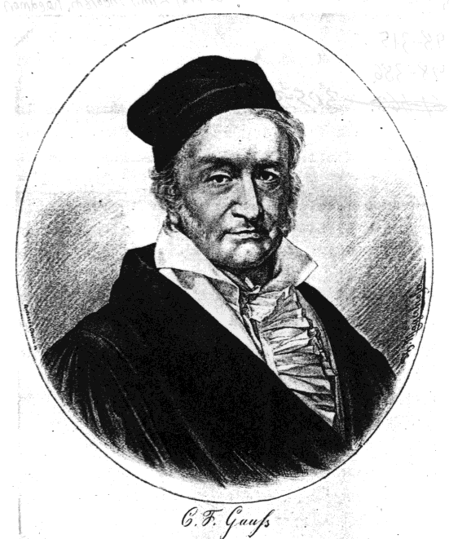
Smoothing: Priors
2σ² = ∞
Gaussian, or quadratic, or L₂ priors:
Intuition: parameters shouldn’t be large.
Formalization: prior expectation that each parameter will be distributed according to a gaussian with mean μ and variance σ².
Penalizes parameters for drifting to far from their mean prior value (usually μ=0).
2σ²=1 works surprisingly well.
2σ² = 10
2σ²=1
They don’t even capitalize my name anymore!

Slide 8
Smoothing: Priors
If we use gaussian priors:
Trade off some expectation-matching for smaller parameters.
When multiple features can be recruited to explain a data point, the more common ones generally receive more weight.
Accuracy generally goes up!
Change the objective:
Change the derivative:
2σ² = ∞
2σ² = 10
2σ²=1
Notes:
Just make mu = 0 in this model.

Slide 9
Smoothing: Priors
If we use gaussian priors:
Trade off some expectation-matching for smaller parameters.
When multiple features can be recruited to explain a data point, the more common ones generally receive more weight.
Accuracy generally goes up!
Change the objective:
Change the derivative:
2σ² = ∞
2σ² = 10
2σ²=1
Taking prior mean as 0
Notes:
Just make mu = 0 in this model.

Slide 10
Example: NER Smoothing
Feature Weights
Because of smoothing, the more common prefix and single-tag features have larger weights even though entire-word and tag-pair features are more specific.
Feature Type | Feature | PERS | LOC
Previous word | at | -0.73 | 0.94
Current word | Grace | 0.03 | 0.00
Beginning bigram | <G | 0.45 | -0.04
Current POS tag | NNP | 0.47 | 0.45
Prev and cur tags | IN NNP | -0.10 | 0.14
Previous state | Other | -0.70 | -0.92
Current signature | Xx | 0.80 | 0.46
Prev state, cur sig | O-Xx | 0.68 | 0.37
Prev-cur-next sig | x-Xx-Xx | -0.69 | 0.37
P. state - p-cur sig | O-x-Xx | -0.20 | 0.82
…
Total: |  | -0.58 | 2.68
Local Context
 | Prev | Cur | Next
State | Other | ??? | ???
Word | at | Grace | Road
Tag | IN | NNP | NNP
Sig | x | Xx | Xx

Slide 11
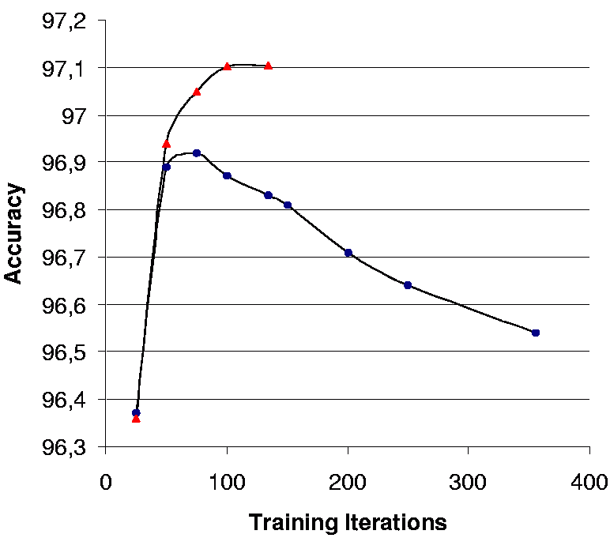

Example: POS Tagging
From (Toutanova et al., 2003):
Smoothing helps:
Softens distributions.
Pushes weight onto more explanatory features.
Allows many features to be dumped safely into the mix.
Speeds up convergence (if both are allowed to converge)!
 | Overall Accuracy | Unknown Word Acc
Without Smoothing | 96.54 | 85.20
With Smoothing | 97.10 | 88.20

Slide 12
Smoothing: Regularization
Talking of “priors” and “MAP estimation” is Bayesian language
In frequentist statistics, people will instead talk about using “regularization”, and in particular, a gaussian prior is “L₂ regularization”
The choice of names makes no difference to the math

Slide 13
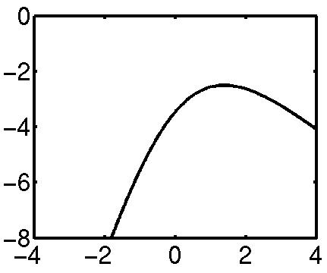
Smoothing: Virtual Data
Another option: smooth the data, not the parameters.
Example:
Equivalent to adding two extra data points.
Similar to add-one smoothing for generative models.
Hard to know what artificial data to create!
Heads | Tails
4 | 0
Heads | Tails
5 | 1

Slide 14
Smoothing: Count Cutoffs
In NLP, features with low empirical counts are often dropped.
Very weak and indirect smoothing method.
Equivalent to locking their weight to be zero.
Equivalent to assigning them gaussian priors with mean zero and variance zero.
Dropping low counts does remove the features which were most in need of smoothing…
… and speeds up the estimation by reducing model size …
… but count cutoffs generally hurt accuracy in the presence of proper smoothing.
We recommend: don’t use count cutoffs unless absolutely necessary for memory usage reasons.

Slide 15
Smoothing/Priors/ Regularization for Maxent Models

